Slide 1
Fall Update 1
Week of October 5
Dev Bhatia
Boston University

Slide 2
Paper Analysis
Liljemalm, R., Nyberg, T. and von Holst, H. (2013), Heating during infrared neural stimulation. Lasers Surg. Med., 45: 469-481. doi:10.1002/lsm.22158

Slide 3
Abstract
This paper is a detailed presentation of a model for the heating during infrared nerve stimulation
Applied for INS of in-vitro neural networks of rat cerebral cortex neurons
Mechanism of heating is the heating of water, inducing changes in cell membranes

Slide 4
The Heating Model – General Description
COMSOL was used to create and implement the model
Most important parameters: laser power, pulse length, pulse frequency, the surrounding temperature, and the distance from the fiber tip to the glass slide
Two main components for heat transport in the model: conduction and convection

Slide 5

The Heating Model- Beam Properties
The laser light was a Gaussian divergent beam with a spreading angle of 17.1°
Power Intensity at an arbitrary point in the volume (I) can be calculated with the equation to the right
I0 = Initial power density
E = laser power
z = z-distance
absw = absorption coeff of water
γ = Gaussian distribution of the intensity
rIo = max radius at any z

Slide 6


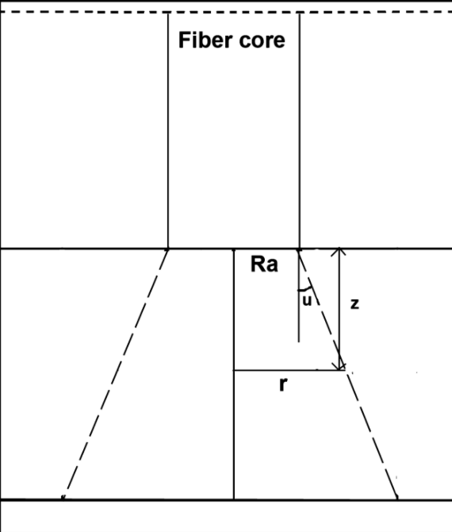
Beam Properties, cont.
rIo = is the maximum radius at an arbitrary z
c = parameter describing gaussian shape
Ra = fiber core radius
z = z-distance
u = spreading angle

Slide 7
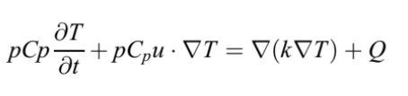
The Heating Model – Heat Transfer
Heat transfer due to convection is based on temperature differences that leads to density variations in a volume, and a resulting flow of mass and heat to equilibrate the system.
P = density
Cp = specific heat capacity at
constant pressure
T = temperature (8C)
t = time (s)
u = velocity vector (m/s)
k = thermal conductivity (W/m K)
Q = heat sources other than viscous heating

Slide 8
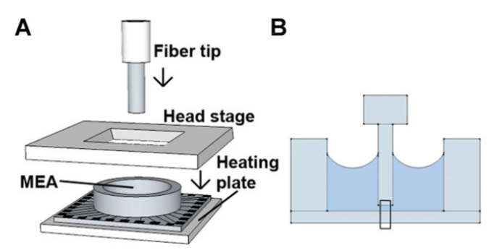
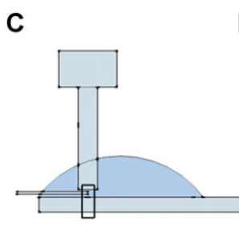
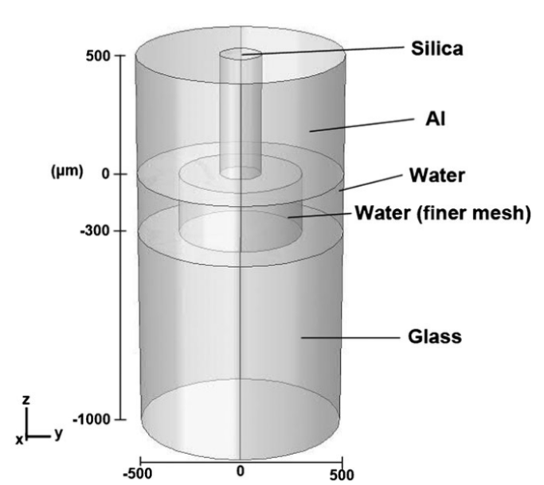
Model-Implemented Experimental Design
The experimental setup is characterized in Figures A,B,and C.
A small portion of the experimental setup is used in the model, shown in Fig. D.
The model uses a 3-Dimensional volume
D

Slide 9
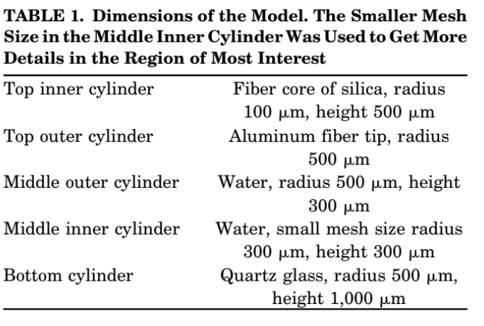
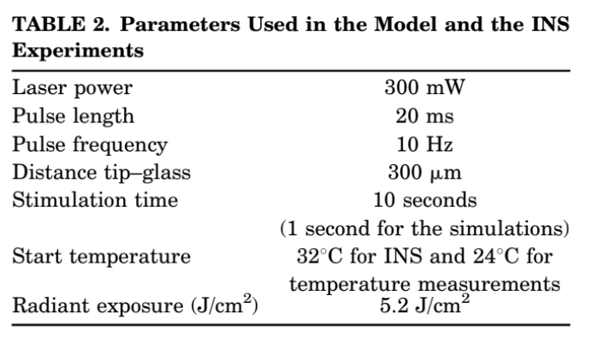
Model Parameters

Slide 10
Model Validation
Simulations were performed using geometry and parameters for oocyte simulation from another group
used two different pulse lengths and energies; a 1 ms, 2.8 mJ pulse and a 2 ms, 5.6 mJ pulse and a wavelength of 1,889 nm (absorption coefficient of 6,060 m-1)
The model was proven to show the spatial and temporal temperature distribution in the heated volume

Slide 11
Next Steps: Two Paths
Following Mohit’s Advice
Following spaciotemporal path
Implement a rudimentary NEURON model
Utilize the Vanderbilt paper to implement the details we have
Temperature simulations from the summer would be placed on the back-burner
Utilize this current paper to improve the temperature simulations from the summer
Repair the simulations from the summer

